Slide 1
IPL Data
The Indian Premier League (IPL), officially Vivo Indian Premier League for sponsorship reasons, is a professional Twenty20 cricket league in India contested during April and May of every year by teams representing 8 Indian cities and some states.
The league was founded by the Board of Control for Cricket in India (BCCI) in 2008

Slide 2
Details about dataset
The dataset consists of IPL data from the season 2008(first season) to 2018 ,dataset consists of the below information about the teams.
1.Information of the teams in the form of team1 and team2
2.information of the winner team in particular matches
3.Information whether the team won through runs or by wickets
4.Information of the umpire1 and umpire3 for particular matches
5.Informartion about the dlr applied or not

Slide 3
Problem Statement
IPL is one of the most popular cricket tournaments in the world and This dataset is having the IPL matches data from the yearend 2008 to 2018.Analyse the data the draw the conclusion

Slide 4
Data Analysis
1.Imported the IPL dataset by using python pandas
2.Performed the profiling i.e analysed the data as part of pre profiling and replacing/dropping all the missing values
Replacing missing entries of umpire1,umpire2 and city with mode.
Dropping the column umpire3
Duplicate names are there for the team Rising Pune Super giant, replaced with single name
3.post profiling the data is perfect to perform the data analysis and perform in depth analysis for each team and column and to know the relation between different factors and how it is affecting the win of the each team

Slide 5
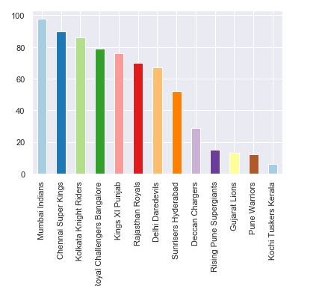
Objectives & Graphs
Which team won highest number of the matches

Slide 6
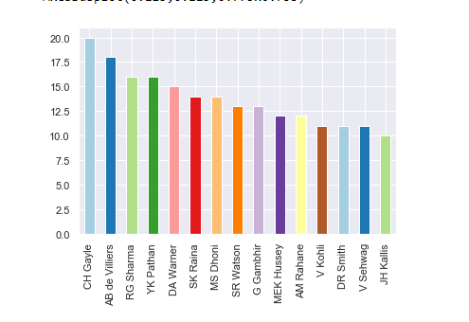
Objectives & Graphs
which player have the more MOM's

Slide 7
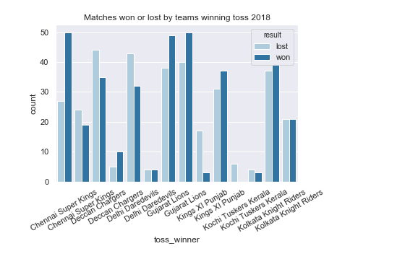
Objectives & Graphs
Does winning the toss has any advantage

Slide 8
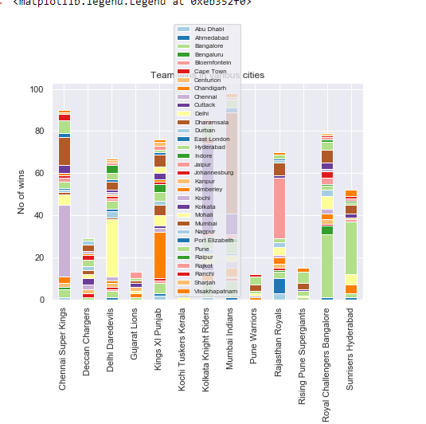
Objectives & Graphs
Is there any home field advantage

Slide 9
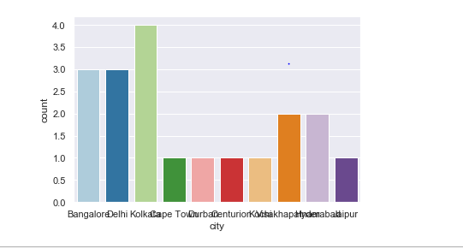
Objectives & Graphs
Mostly DI is applied in which city

Slide 10
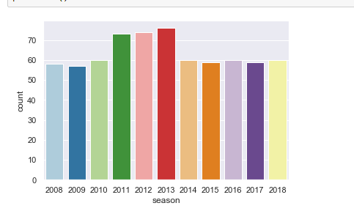
Objectives & Graphs
Highest number of matches were played in season

Slide 11
Analysis from Above Graphs
1.Most number of matches were won by mumbai Indians
2.Chris Gayle has the most MOM's
3.For Chennai super kings winning the toss has a clear advantage
4.There is a home filed advantage for the team
5.Most number of matches were played in season 2013

Slide 12
Conclusion
Mumbai Indians and Chennai super kings has high chances of winning the next season

